Slide 1
21.01.2025
Pascal

Slide 2
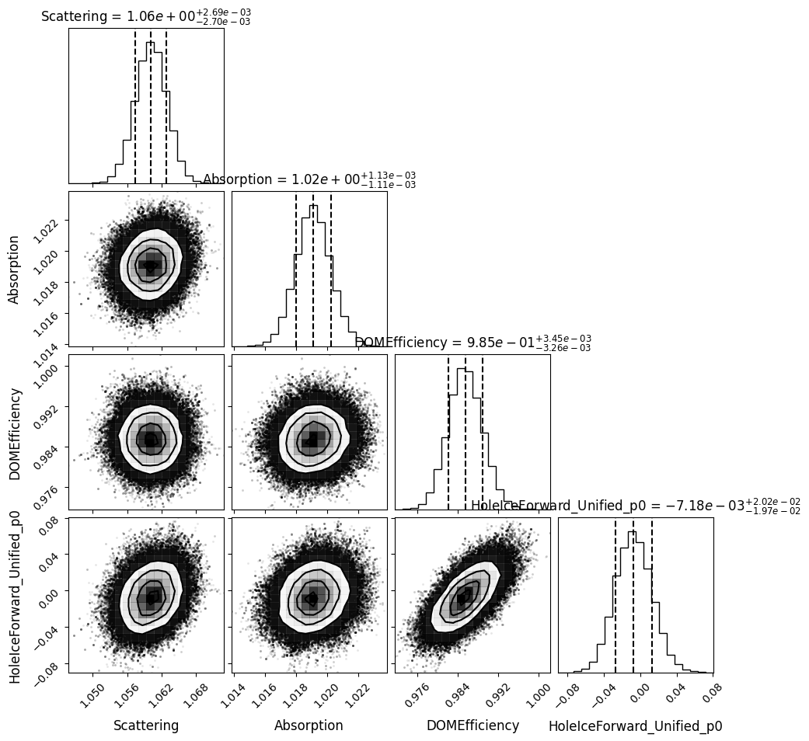
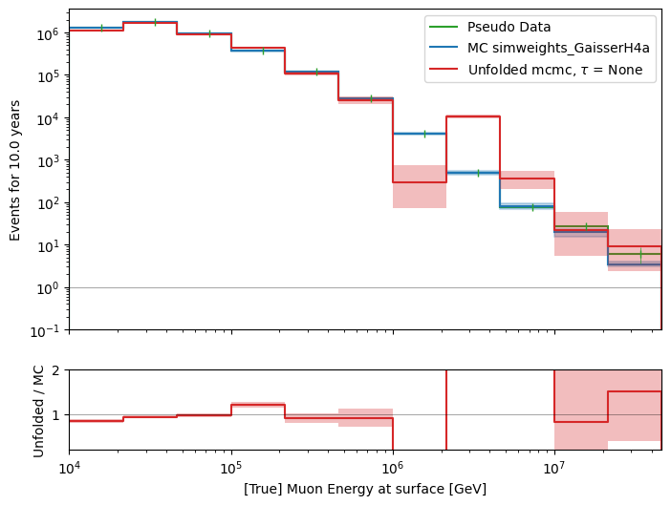
Unfold event rate, 4 systematics, MCMC
X0 = [True values, 1, 1, 1, 0.2]
n_used_steps = 1000
n_walkers = 500
n_burn_steps = 1000

Slide 3
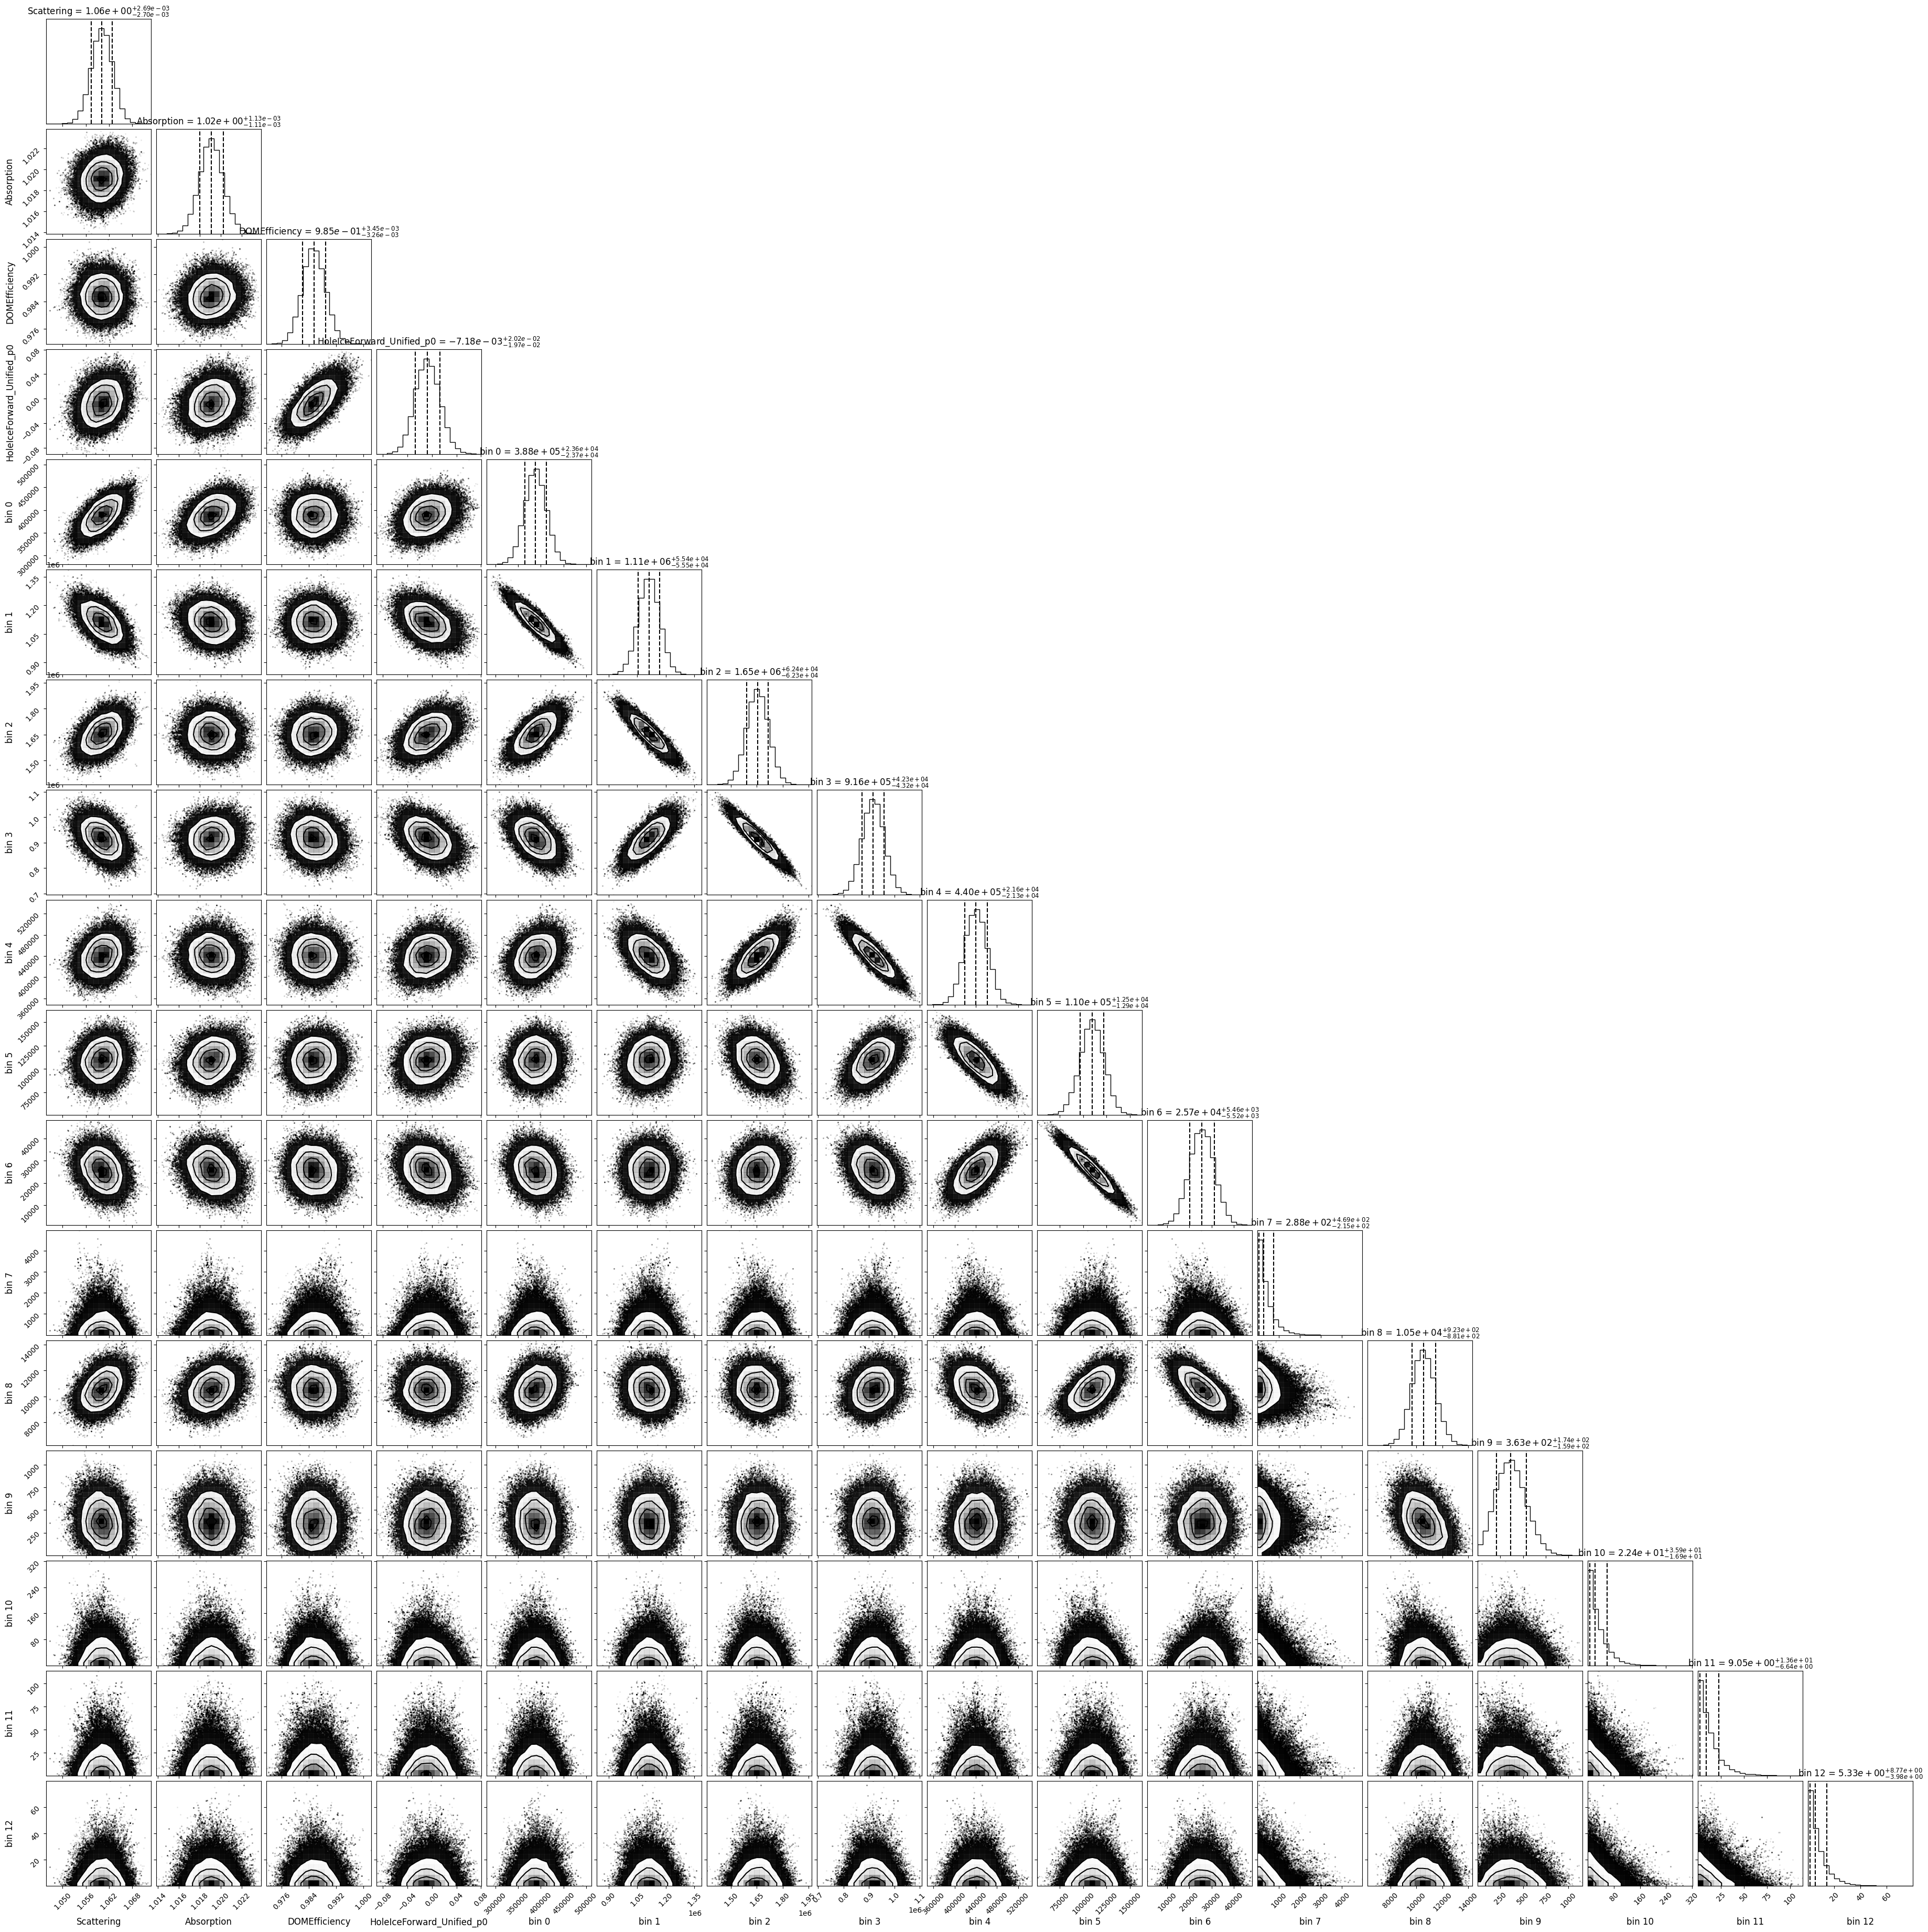

Slide 4
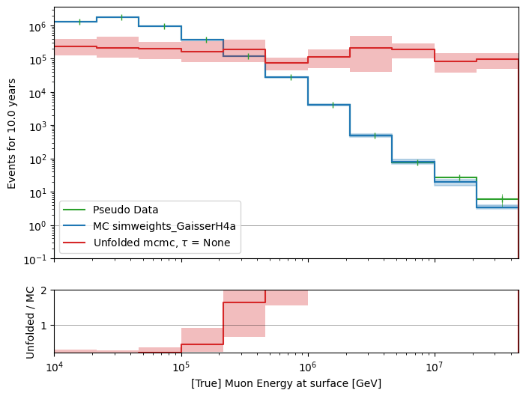
Unfold event rate, 4 systematics, MCMC
X0 = [1e5,., 1, 1, 1, 0.2]
n_used_steps = 1000
n_walkers = 500
n_burn_steps = 1000

Slide 5
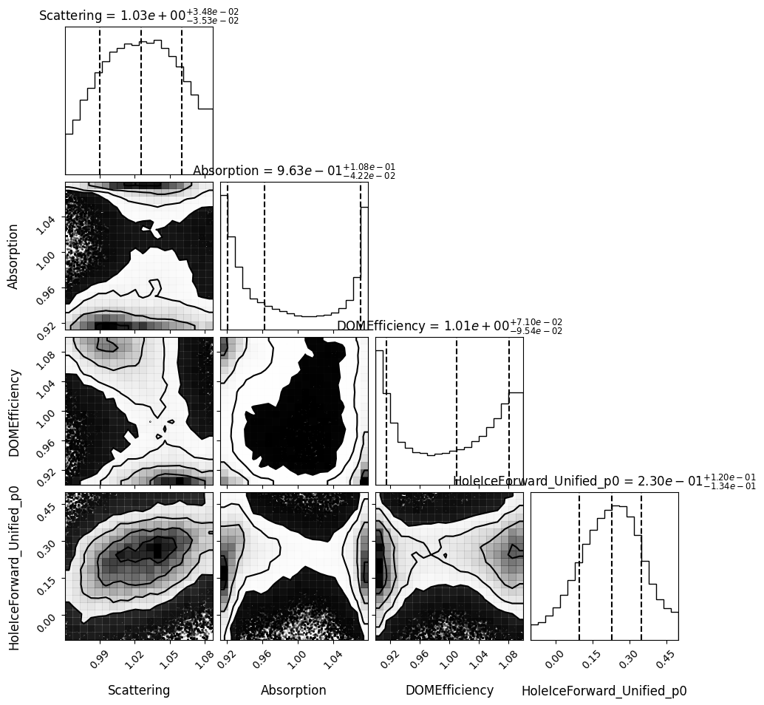
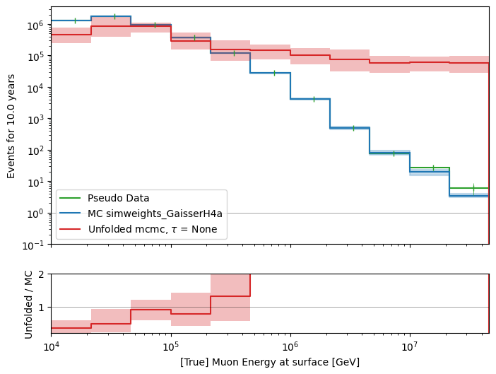
Unfold event rate, 4 systematics, MCMC
X0 = [1e5,., 1, 1, 1, 0.2]
n_used_steps = 2000
n_walkers = 700
n_burn_steps = 2000

Slide 6
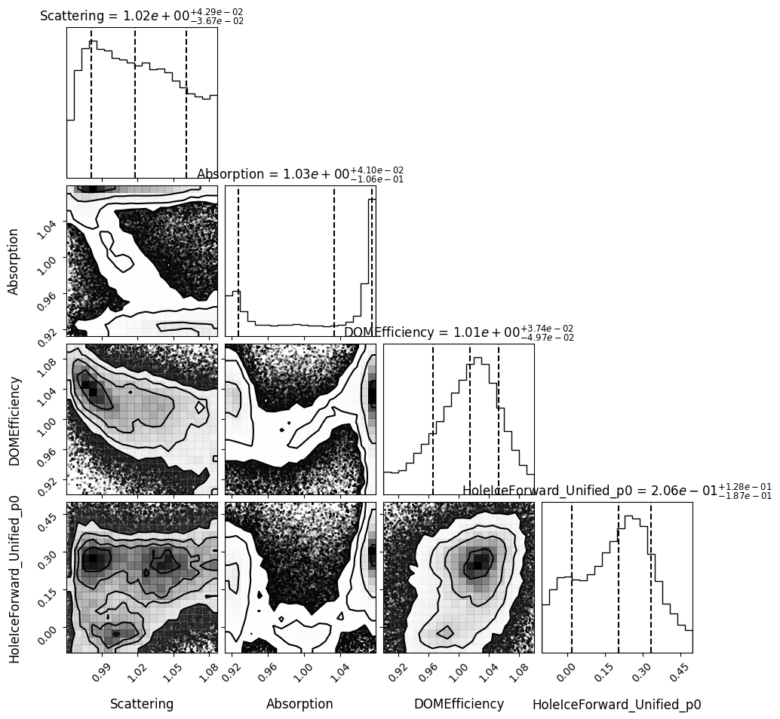
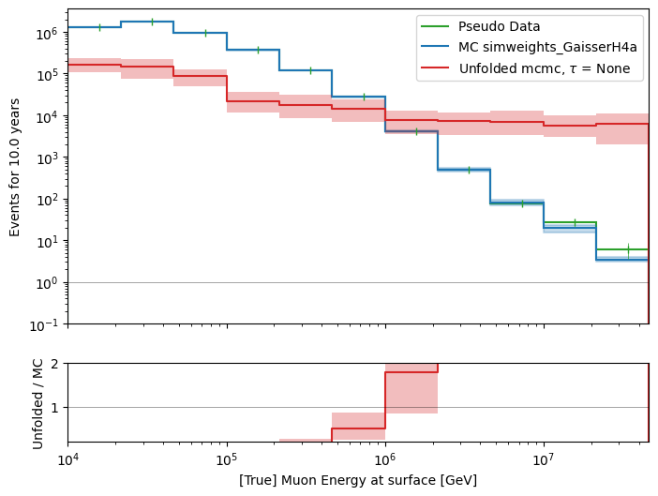
Unfold event rate, 4 systematics, MCMC
X0 = [True values * 0.1, 1, 1, 1, 0.2]
n_used_steps = 1000
n_walkers = 500
n_burn_steps = 1000

